Slide 1



aMIGO: COGNITVE-BEHAVIOURAL THERAPY CHATBOT
A capstone thesis submitted in partial fulfilment of the requirements for the degree of:
BACHELOR OF TECHNOLOGY in SOFTWARE ENGINEERING
By
TAPIWA S. ZENGEYA
H170170Q
mr.tapiwazengeya@gmail.com
Under the guidance of
Eng M. MUTANDAVARI
LECTURER & PROJECT SUPERVISOR
School of Information Science and Technology
Harare Institute of Technology
BE227, Ganges Road, Belvedere
Harare

Slide 2

Project Overview
Introduction
Objectives
Methodology
Results
Conclusion & Future Works

Slide 3
Introduction
There has been increased concerns over mental health problems in Zimbabwe and all over the world. Recent spikes in cases related to mental health issues have been caused by effects of covid19, loss of loved ones, the lockdown measures and more.
This led to a lot of people failing to cope with these effects and spiraling into anxiety and depression, unfortunately, health facilities that can help people to cope with such issues are expensive and there is a stigma associated with people going for therapy especially in Zimbabwe. There are also other issues that render them limited such as bookings of sessions, because anxiety and depression can hit at any time yet that person hasn’t booked a session. It leaves them vulnerable to the effects of mental health issues.

Slide 4
Cont…
This project aims to provide people facing mental health issues with cognitive behavioral therapy advice and information on mental health at anytime of day.
It also goes further to provide information for local therapy resources such as hotlines and emergency lines when a critical conditions arise.

Slide 5
Objectives
To develop a chatbot that gives CBT therapy advice.
To provide awareness on mental health.
To develop a chatbot that is available 24/7
To develop an interface that can be accessed on any device efficiently

Slide 6
Methodology
User enters input on web interface.
NLTK and Lemmatizers used to convert input words into tokens.
Tokens fed to Sequential Keras Neural Network Model which matches the intent patterns to the response patterns.
Model returns appropriate response, shown as a reply.

Slide 7
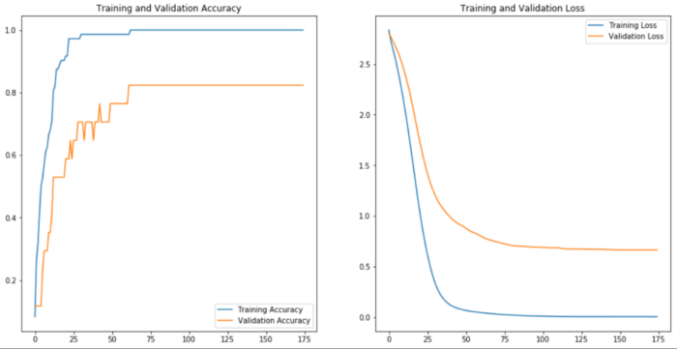
Training Results

Slide 8
Conclusion and Future Works
Objectives were met successfully with all components being functional.
The future works on this system that I recommend are that the Model be able to adapt and update its dataset automatically, using a certified online source established by professionals in the field. This helps the model to be up to date with the mental health topic that is still under intensive study

Slide 9

Thank You!
During the course of the year, working on this project, it has opened my eyes to a problem that is known all over but has minimal efforts from the general public in resolving. Mental Health is a silent and slow killer of not only the brain but of all areas of our lives. So apart from taking care of our own mental health, let us safeguard that of our loved ones and our neighbours.
Visit friendshipbenchzimbabwe.org
Tapiwa simbarashe zengeya
h170170q

